Slide 1
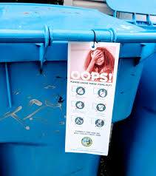
How to Enlighten Recycling Education in our University?
“Things tell a Story” (William James, 1907: 96)
David M. Boje
davidboje@gmail.com

Slide 2
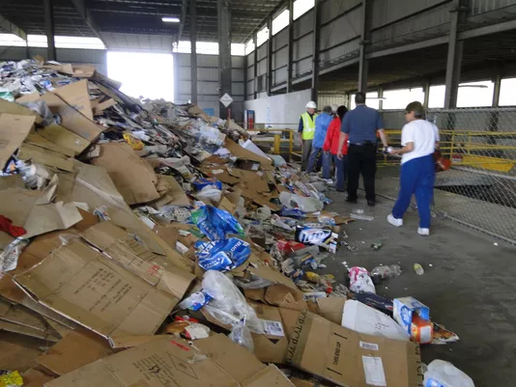
Sun News, 2018
“Things tell a Story” (William James, 1907: 96)
Our recycling of things tells a story
“Contamination” means residents putting materials in their blue bins that are NOT recyclable – food, trash, and various non-recyclable materials.)
Notes:
Time is running out as US land fill capacities fill up https://nrra.net/sweep/time-is-running-out-the-u-s-landfill-capacity-crisis/

Slide 3
Japan and US
With similar, GDP, Japan generates 1/3rd less waste than the US
US throws out 4.5 pounds trash per person per day

Slide 4
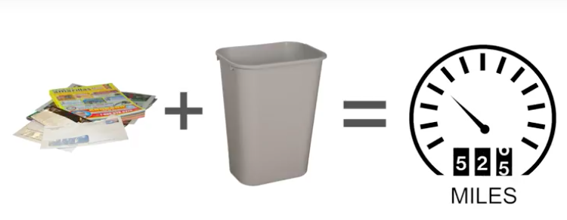
If you throw away even half the paper you use in a year instead of recycling it, you increase your climate pollution by the same amount as driving 526 miles

Slide 5
The Global Scale of Recycling
Globally only 14% of plastic packaging is recycled & 8M tons ends up in ocean yearly (Washington Post, 2018)
Electronic Waste 50 million metric tons in 2018; 25% is personal E-waste (UN Report)
Until 2018 China took 50% of world’s plastic & paper recycling waste; but now bans 24 types of solid waste, including various plastics and unsorted mixed papers, and sets a much tougher standard for contamination levels (Environmental Paper Org)
Recycling creates about 1.25 million US jobs (Guardian, 2017)
Notes:
https://www.washingtonpost.com/outlook/five-myths/five-myths-about-recycling/2018/04/20/9971de66-43e6-11e8-8569-26fda6b404c7_story.html?noredirect=on&utm_term=.c0f4b35711f0
https://www.popularmechanics.com/science/environment/a3736/4290631/
https://www.wastedive.com/news/what-chinese-import-policies-mean-for-all-50-states/510751/
https://www.csbsju.edu/sju-sustainability/what-were-doing/recycling/recycling-myths-and-excuses
https://www.motherjones.com/environment/2015/07/recycling-myths-blue-bins/

Slide 6
New Mexico in Global Crisis
New Mexico among 1st states to feel crisis effects in 2017 (NM Recycling Coalition).
Many NM municipalities stopped receiving rebates in fall 2017.
There are slower line speeds, extra labor (50 new staff in Albuquerque) to meeting China’s new rules.
Same for Las Cruces. Cities in NM beginning to see material pile up due to continuous low pricing.
Las Cruces paying additional $40,000 a month; Santa Fe paying $540,000
Las Cruces will inspect carts for contamination in September 2018, and issue ‘Oops’ tag. (Waste Dive)

Slide 7
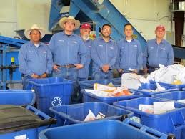
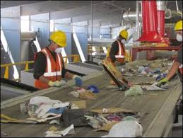
Is NMSU Declining in Recycling
Let’s take a look at the College of Business recycling systems?

Slide 8
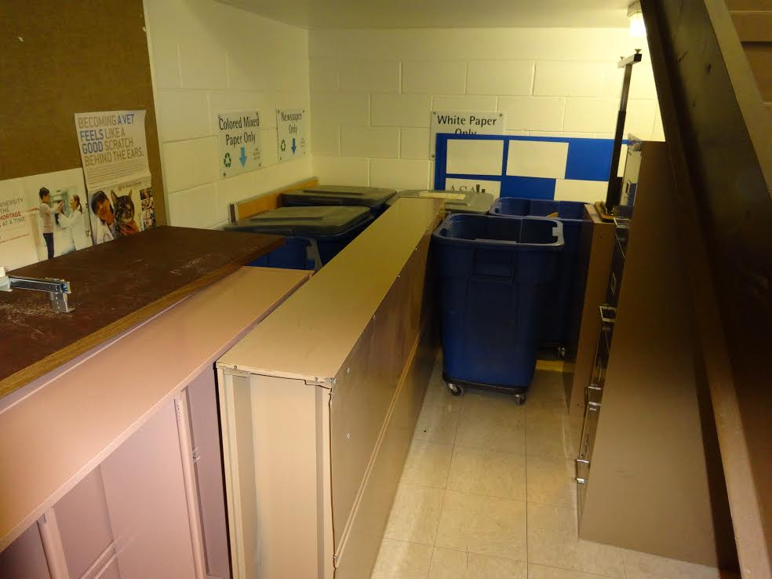
Recycling in Business Complex Building moved from lobby and third floor locations to beneath the first floor stairwell
THINGS TELL A STORY
Observe the Micro-Spaces of THINGS telling a story

Slide 9
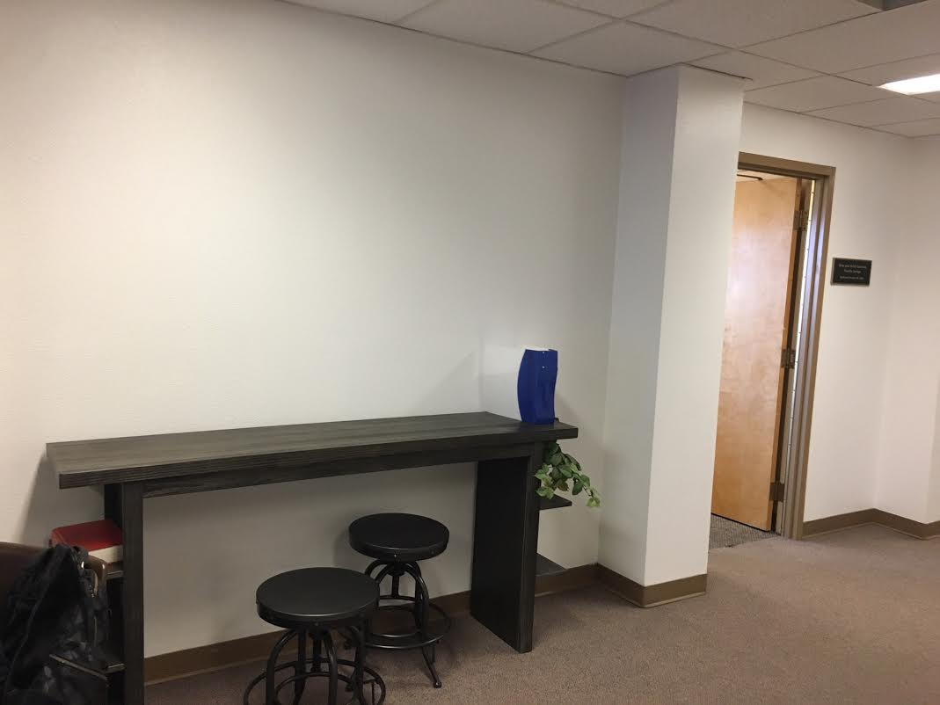
Two months ago there used to be 3rd Floor Business Complex recycling center, with signage
ABSENCE of RECYCLE BINS TELL A STORY

Slide 10
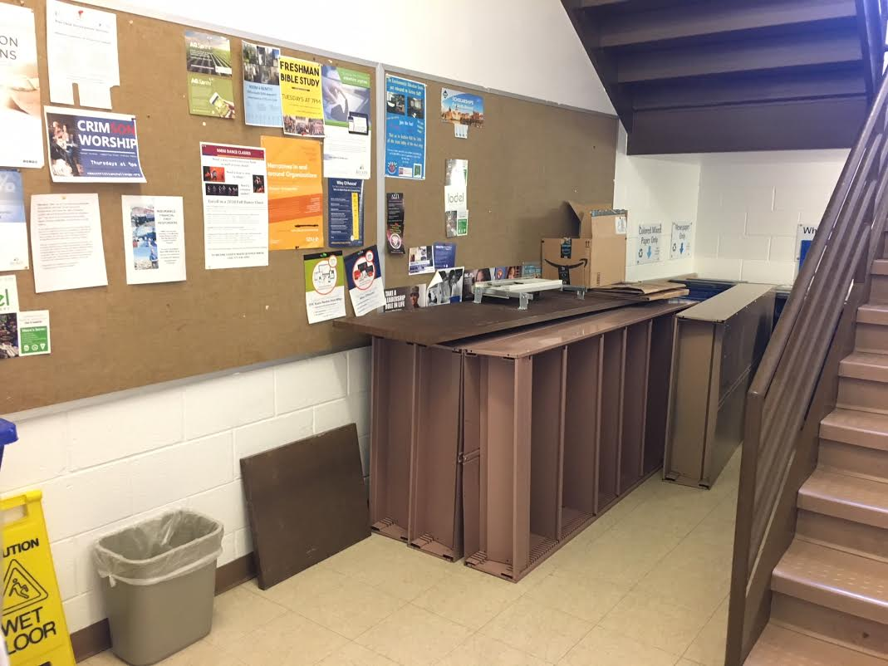
1st Floor Business Complex has recycling all under stairway
THINGS TELL A STORY

Slide 11
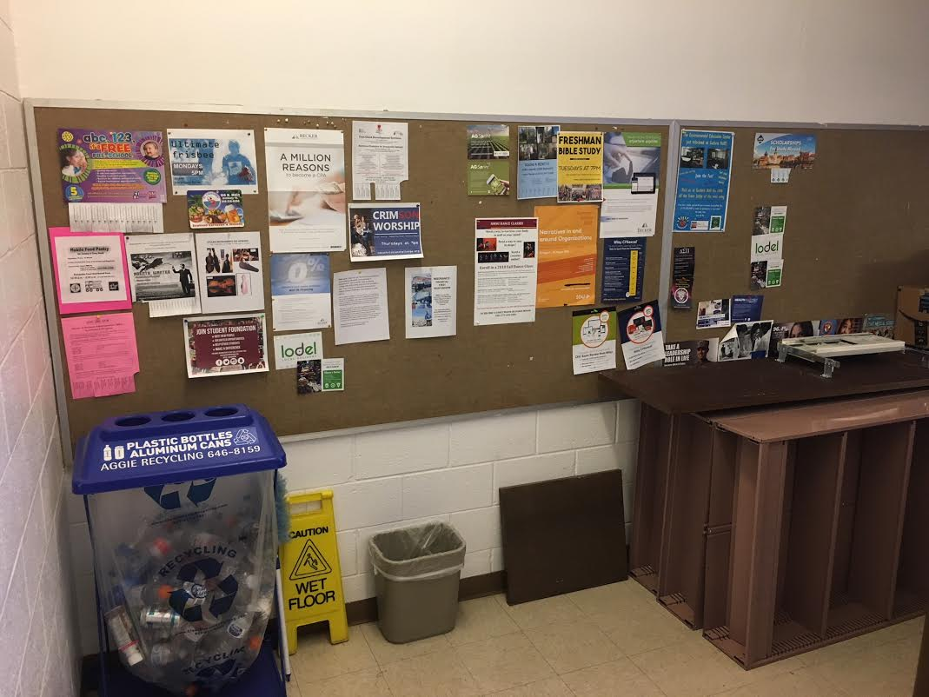
Location of Aluminum can/plastic recycling is in Business Complex 1st floor stairwell instead of near larger classrooms on all three floors
THINGS TELL A STORY

Slide 12
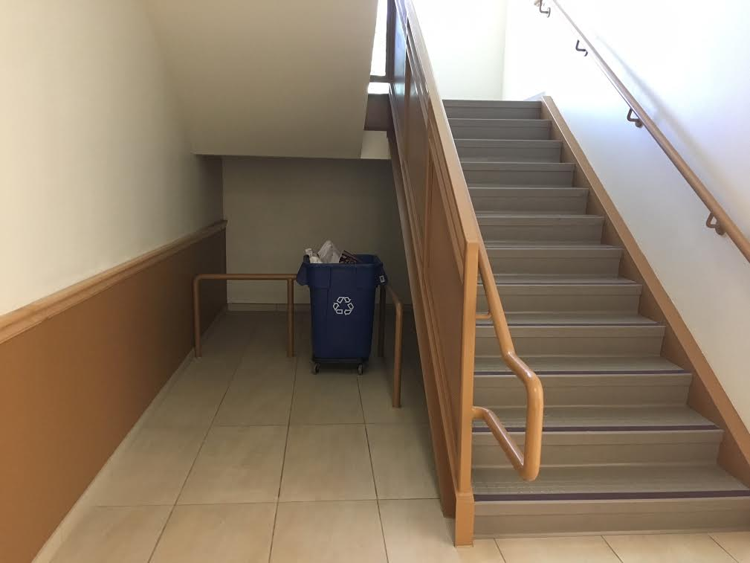
Domenici Building – recycling is in stairwell instead
THINGS TELL A STORY

Slide 13
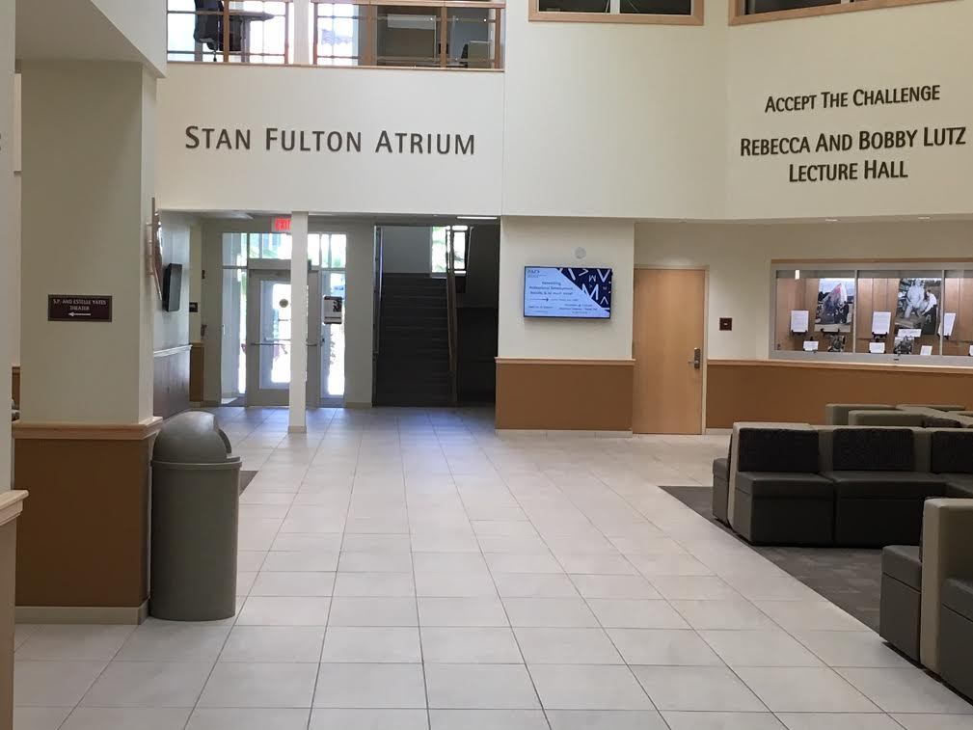
Can we find a way to have recycling in main areas (Domenici Building example)
Observe the Micro-Spaces of THINGS telling a story
ABSENCE of RECYCLE BINS TELL A STORY

Slide 14
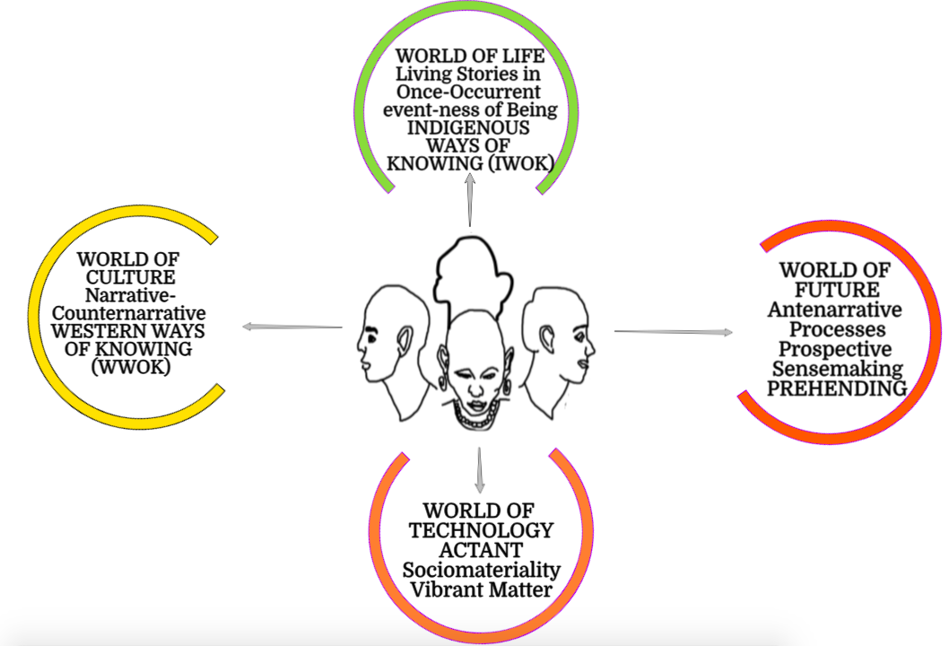
Fourfold Faces & Worlds of Storytelling

Slide 15
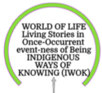
LIVING STORIES: A river and a mountain now have legal rights of a person in New Zealand
We are each MORALLY ANSWERABLE for our day by day TRACH in the event-ness of Being
We live in the WORLD OF LIFE

Slide 16
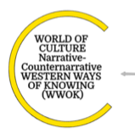
WWOK treats earth as a resource to be plundered
The counternarrative is Earth resources are being depleted

Slide 17
ACTANTS are things Things are material intra-acting with Social habits & routines
Consumption and production are human routines, consuming and producing THINGS
Technology is equipment & tools to make consumable things

Slide 18
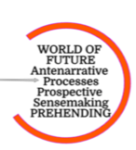
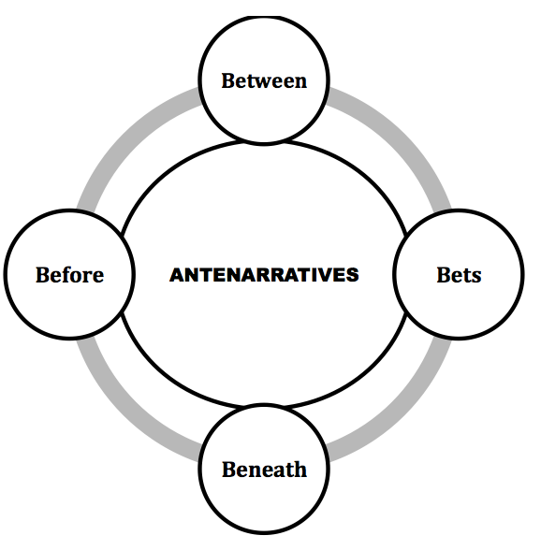
Antenarrative means Preparing in Advance for the Future Choosing Which Future to Actualize
PREHENSION – grasping some THING, taking control of things, to manage the Future

Slide 19
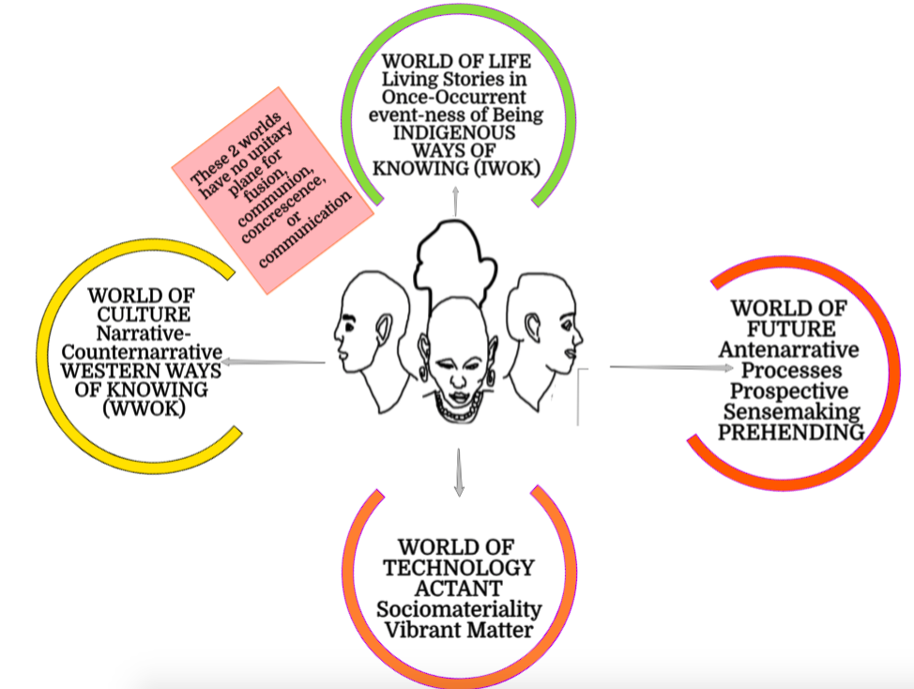
THE GAP BETWEEN 2 of the WORLDS

Slide 20
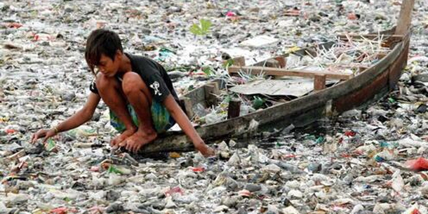
A block between WORLD OF CULTURE & WORLD OF LIFE
Plastic Things Tell A Story
The World of Culture produces Waste which Kills World of Life faster than we can RECYCLE, REDUSE, REUSE

Slide 21
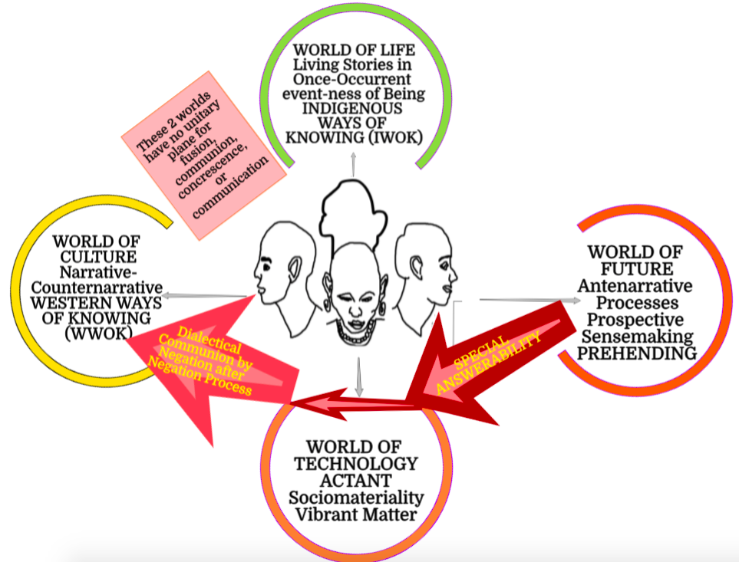
FIRST ANTENARRATIVE PROCESS IS DIALECTICAL

Slide 22
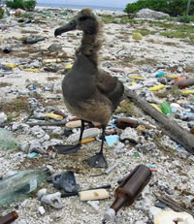
World of Culture ➔World of Technology is polluting World of Life
Besides killing wildlife, plastic and other debris damage boat and submarine equipment, litter beaches, discourage swimming and harm commercial and local fisheries. The problem of plastic and other accumulated trash affects beaches and oceans all over the world, including at both poles. Land masses that end up in the path of the rotating gyres receive particularly large amounts of trash.

Slide 23
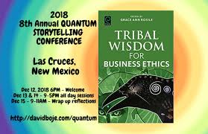
Antenarrative PATH 2
Learn INDIGENOUS Ways of Knowing & Being that are in Balance with World of Life

Slide 24
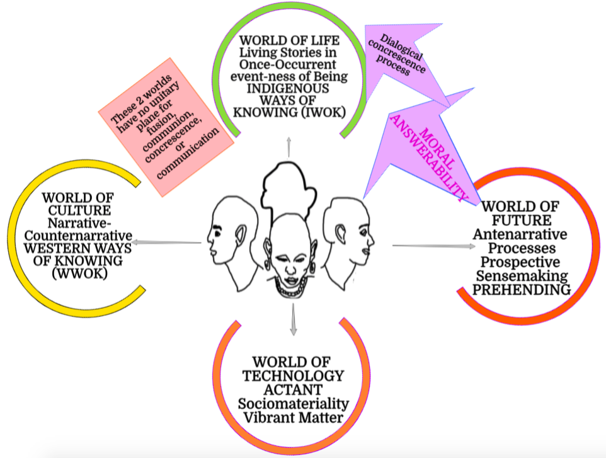
2nd ANTENARRATIVE PROCESS IS DIALOGICAL

Slide 25
Walter Benjamin 1936
Said “Storytelling is Coming to an End”
Because the skill to tell a living story and to listen and understand living story is less than it was
Why? Because workers no longer allowed to sign and tell stories at work
Because of the rise of Western Narrative that is disconnected from CONTEXT, UNGROUNDED to Mother Earth

Slide 26
IWOK Storytelling is Coming to an End
IWOK Storytelling of relation of World of Live to Ethical Answerability giving way to World of Culture Narratives
Many World of Culture Narratives promise CORPORATE SOCIAL RESPONSIBILITY that is FAKE NARRATIVE, ILLUSION, or GREENWASHING

Slide 27
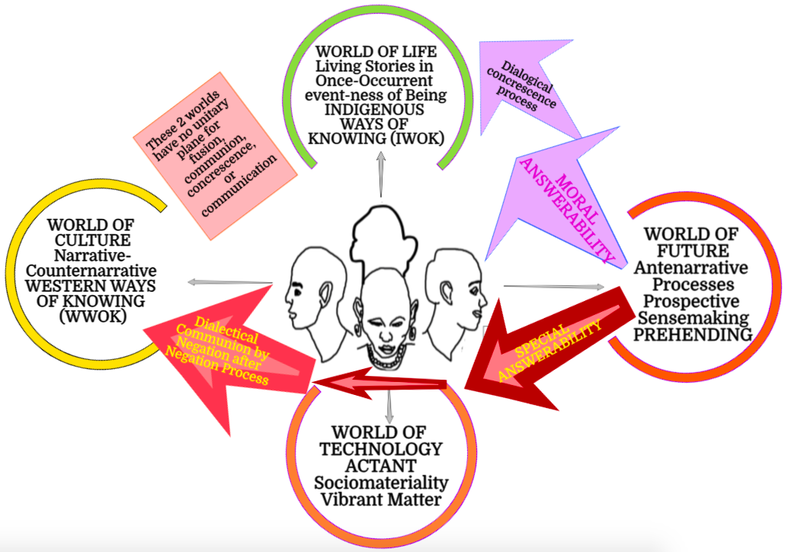
4-Fold Storytelling Paradigm

Slide 28
What does Søren Brier’s Cybersemiotics approach contribute Storytelling?
integration of IWOK-living story knowledge and Narrative of the Other-intersubjective with BEING in the Natural World of BIOLOGY/MATTER/ENERGY
‘Cybersemiotics’ integrates Charles Sanders Peirce's semiotics (both numeric- and qualitative-multiplicity of open series of some 24 triads) with the autopoiesis of Niklas Luhmann's cybernetic ‘closed’ systems theory of three autopoieses.

Slide 29
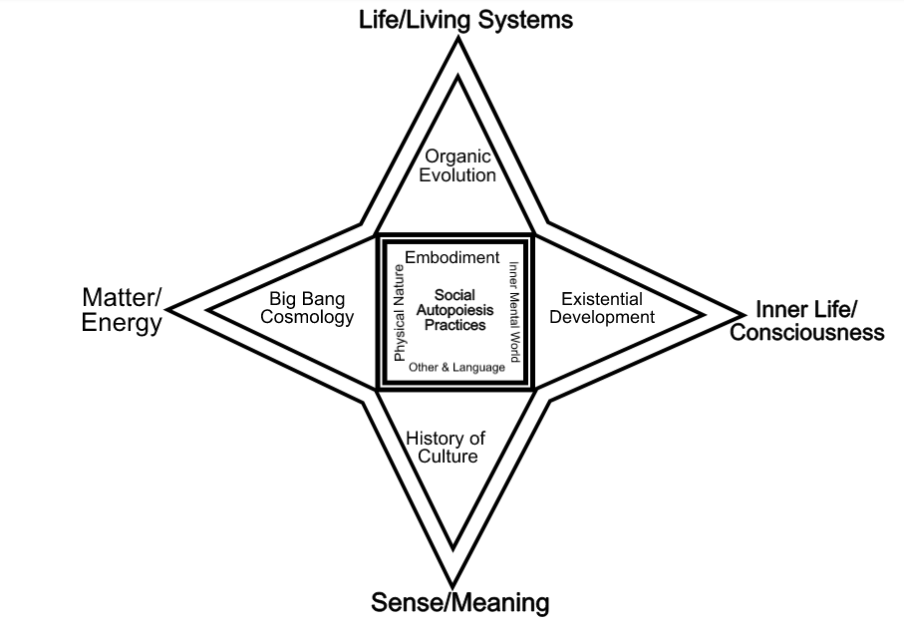
Figure 27: Rendition of Brier’s Star Model of Cybersemiotics (Image by D. Boje, 2017)
Antenarrative (bets)
(World of FUTURE)
Living Story
(World of LIFE)
Actants (Things)
(World of TECHNOLOGY)
NARRATIVE
(World of CULTURE)

Slide 30
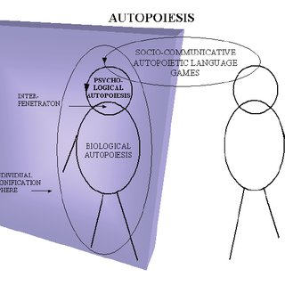
Definition of Autopoiesis
A system of processes capable of reproducing and sustaining itself
Pollution and Greed are BAD autopoiesis
Recycling and Upscaling is GOOD autopoiesis
Three types of Autopoiesis

Slide 31
Socioeconomic Consulting and Autopoiesis
People have routines of production and consumption that become +/- habits
Mental Habits of Sensemaking – autopoiesis
Cultural Socio-Communicative Habits - autopoiesis
Bio-Physical Habits of production & consumption in relation to Mother Earth – autopoiesis

Slide 32
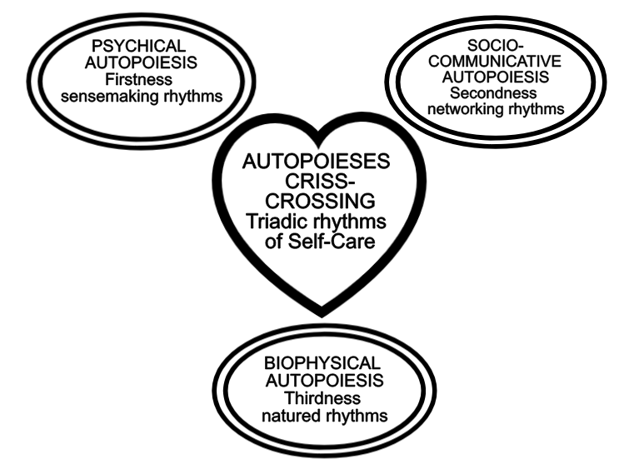
Figure 28: Autopoieses Crisscrossing Triadic Rhythms of Self-Care (figure original by D. M. Boje 2017)

Slide 33
In Analyzing SEAM interviews/Observations/Focus Groups/Documents
Look for Signs of Mental routines
Look for Signs of Behavior routines
Look for Dysfunctions in routines
Look for Hidden Costs of routines (habits)
Look at how to unleash human potential in LIVING STORIES of new Balance of LIFE WORLD, TECHNOLOGY WORLD, and FUTURE WORLD

Slide 34
Signs Objects & Interpretants in SEAM CONSULTING
Sign is anything that communicates meaning
OBJECTS tells a ‘story’ about a SOME-THING
“Interpretant” refers to a sign that serves as the representation of an object.

Slide 35
Things tell a story
Not just people tell stories
Things tell a story
Assemblages of things tell a story
Pictures tell a story
Stuff you carry with you tells a story
Things in your office tell a story
Things are ACTANTS mediating Human Routines in a business

Slide 36
Antenarratives are processes
Antenarratives are choices among FUTURES
Business prepares in advance for this or that Future
Antenarrative constitutes BEFORE narrative or story
Antenarrative is before, beneath, becoming, between, and bets on the future coming

Slide 37
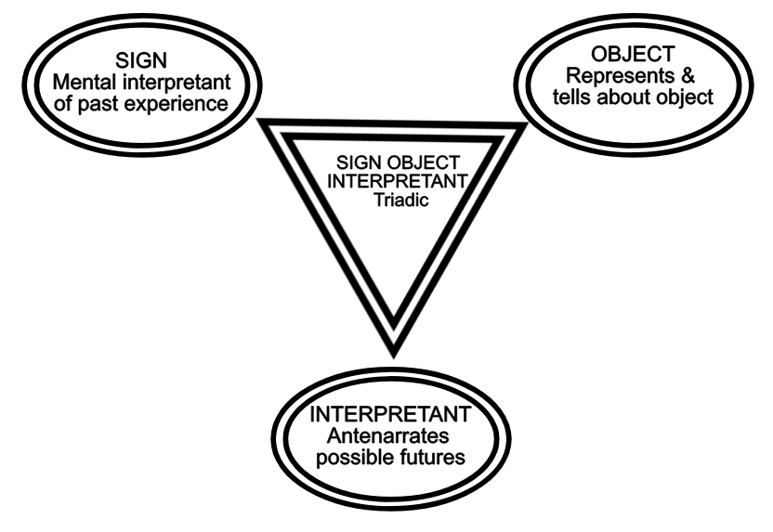
Sign-Object-Interpretant Triadic (figure original by D. M. Boje, 2017)

Slide 38
The Agential Cut
Narratives, Stories, and Antenarratives make AGENTIAL CUTS
AGENTIAL CUTS make a boundary of what is IN and what is OUT
AGENTIAL CUTS are entanglements of MATERIAL THINGS with DISCOURSE
Narratives, stories, and antenarratives are constituted in material-discursive intra-actions

Slide 39
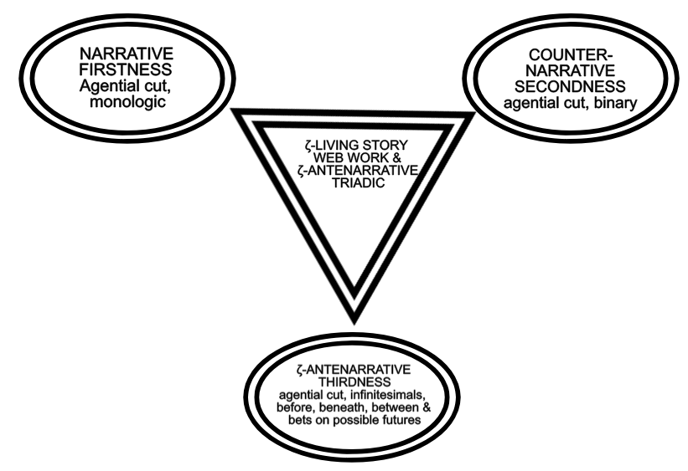
Figure 24: ζ-antenarrative Thirdness cusps of difference, infinitesimal, and disruption to narrative Firstness, and Secondness-counternarrative (figure original by D. M. Boje 2017)

Slide 40
Narrative-Counternarrative
Makes a DIALECTICAL agential cut
The master narrative opposed by counternarratives
The dominant narrative opposed by counternarratives

Slide 41
Living Stories are DIALOGICAL
One kind of dialogical, is polyphonic
Polyphonic means many voices
Another kind of dialogical, is stylistic
Living Stories are many stylistics (oral speech, sign language, textual, body language, dramaturgy, and/or architectural
To be multi-stylistic, different modalities of story (some material like sound waves or photos, and others verbally discursive) are entangles

Slide 42
Summary: How to Enlighten Recycling at Universities
Things Tell a Story
Get Forensic about Recycling
Question Greenwashing
Where are the actual recycling systems, the bins, the places to recycle
What is happening to material things you recycle?

